Slide 1
Tutorail 01.
How to style a RIA webpage

Slide 2
Outline
Tools
Analysis page layout
Styling

Slide 3
Tools
Sublime Text
LiveReload
Page ruler
ColorZilla

Slide 4
Outline
Tools
Analysis page layout
Styling

Slide 5
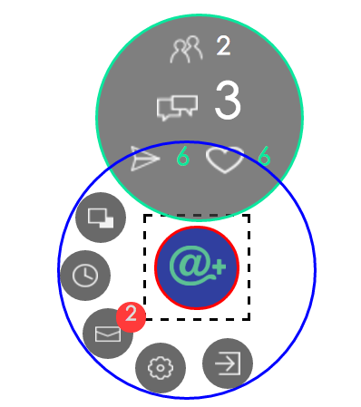
#info-bar
#button
#control-ring-container
#apb

Slide 6
Outline
Tools
Analysis page layout
Styling

Slide 7

Styling
Styling transitions
Styling :hover
Basic Layout

Slide 8
Styling
Styling transitions
Styling :hover
Basic Layout

Slide 9
Styling
Styling transitions
Styling :hover
Basic Layout

Slide 10
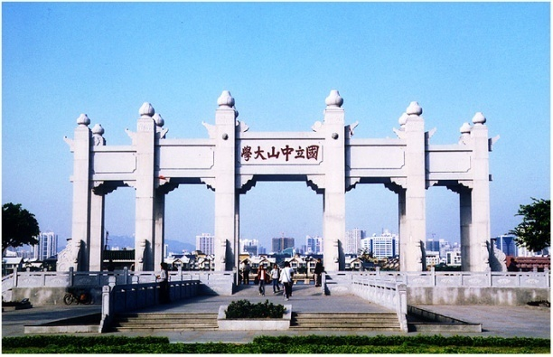
Thank you!

